Slide 1
EFFECTIVE STRATEGIES WORKING WITH THE URBAN LEARNER AND FAMILIES
PRESENTATION BY
Dr. GEORGE E. FITCH

Slide 2
Goals of the Presentation
Identify Effective Strategies that work with the Urban Learner.
Knowing How to Communicate with the Urban Learner and Families.
Develop Confidence in Urban Environments and School Situations.
Develop a Better Understanding of the Urban Learner.
Enjoy Yourself in the Presentation!

Slide 3
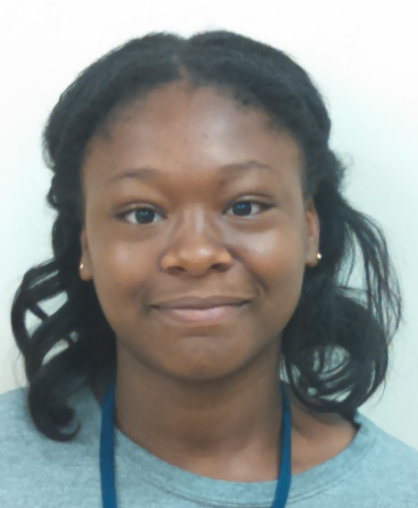
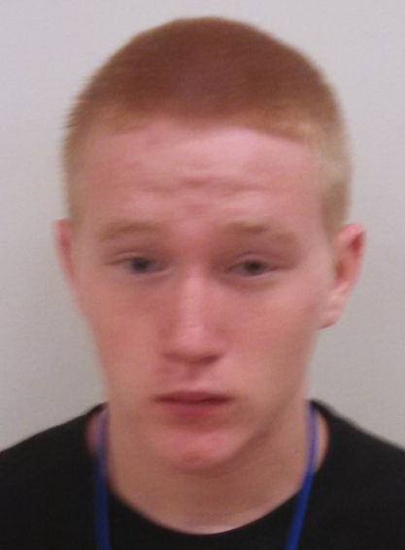
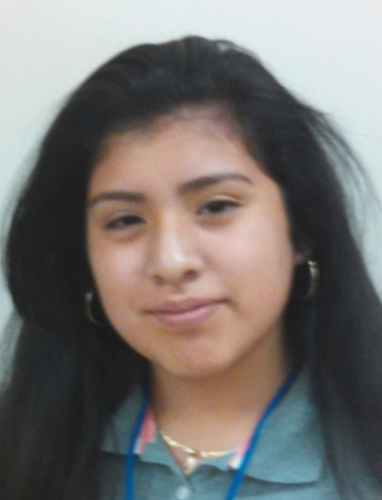
Defining the Urban Learner
Notes:
The urban learner is described as a student being an active participant in anurban educational and learning environment. The urban learner includes such racial minorities as Native Americans, African Americans, Mexican Americans, Puerto Ricans, and a substantial number of poor Whites ( Martin, 1975 )

Slide 4
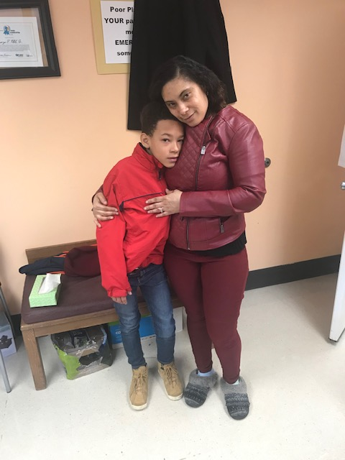
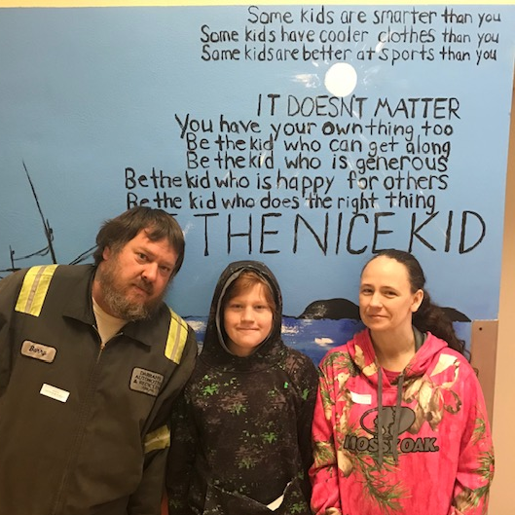
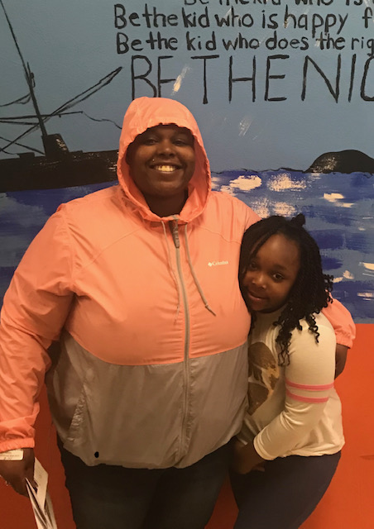
Urban Families

Slide 5
Developing Connections
https://www.ted.com/talks/rita_pierson_every_kid_needs_a_champion

Slide 6
Building Relationships
In my experiences with the Urban Learner this is how it looks and sounds:
The adult calls me by my name, or what I like to be called.
The adult acknowledges my raised hand.
The adult talks to me respectfully
The adult makes a home visit and highly visible
The adult embraces my culture
The adult communicates with my family
The adult cares about me

Slide 7
Building Relationships (cont.)
In my experiences with Urban Families these strategies work:
The teacher knows the correct name to address the parent, guardian or family member.
The teacher asks is this an appropriate time to call and speak to the person.
The teacher listens to the family and works to answer some of their questions
The teacher always has a positive to say and works to develop a rapport with the family
The teacher looks for connections and similarities

Slide 8
Communication is Critical
Realities that many Urban Families face are substantial and daunting. Many realities are time poverty, lack of access, lack of financial resources, and lack of awareness. (Williams and Sanchez, 2011)
Adults working with the Urban Learner and their families must be able to effectively communicate through difficult situations (Epstein, 2011)
The Comer Model has been effective for communicating with families, collaboration, consensus-building, and no-fault approach to problem solving (Comer, 2004)

Slide 10
Strategies in Urban Situations
As adults working who could interact in an urban setting, it is in everyone’s best interest to know the setting and community. Here are some strategies that have helped me:
Respect / Dignity
Being Highly Visible
Making Home Visits
Attending Community Events
Showing Confidence
Being Yourself

Slide 11
More Strategies
Knowing when to use Humor
Staying Calm
Being Empathetic
Recognizing Social Cues
Building Rapport
Active Listening
Not saying too much

Slide 12
Engaging the Urban Learner
Making things clear and consistent will enable all students to understand material, but especially the urban learner (Williams and Sanchez, 2011).
Having multiple ways for students to demonstrate their understanding (Gardner, 2008).
Through multiple types of responses (verbal, written or action) the majority of students will be participating and students will be engaged in the learning (Rosenshine, 2012).

Slide 13
Engaging the Urban Families
Schools must listen to parents, families and the community, and solicit them for their suggestions on how to work with their children (Baker, Wise, Kelley, & Skiba, 2016; Epstein, 2001).
Families in poverty are concerned about their child’s education and want the best for their child, but the circumstances of survival are at times more pressing (Noel, Stark & Redford, 2015).
It comes to the discussions of the parents, families and staff developing an understanding of the family condition. It is then when staff develop this mindset that they can build a trusting relationship with the parent and family that will enable schools to foster student success (Ng & Rury, 2006).

Slide 14
Engaging the Urban Families
When using a more positive and proactive approach and not starting or looking at the negative first, schools can really look to build more positive communication with the families
Furthermore, personnel must think and work flexibly to lessen barriers to parent engagement
When schools implement a cross-cultural approach in working with families, it has been shown that there is more of a connectedness to the school and trust is built (Machen, 2005).

Slide 15
Strategies Reaching the Urban Families
Schools must listen to parents, families and the community, and solicit them for their suggestions on how to work with their children (Baker, Wise, Kelley, & Skiba, 2016; Epstein, 2001).
Families in poverty are concerned about their child’s education and want the best for their child, but the circumstances of survival are at times more pressing (Noel, Stark & Redford, 2015).
It comes to the discussions of the parents, families and staff developing an understanding of the family condition. It is then when staff develop this mindset that they can build a trusting relationship with the parent and family that will enable schools to foster student success (Ng & Rury, 2006).

Slide 16
Conclusion
There is no FOOL PROOF anything! I have just shared with you what has been successful in my own interactions with the urban learner. I hope that you can use some of what I have shared to make sure that you can have an impact on the lives of the students that you touch.
If you need anything or want to reach out, please know that I am available.

Slide 17
Thank you
Any Questions or Comments?

Slide 18
References
Comer, J. P. (2004). To Leave No Child Behind. What I Learned in School: Reflections on Race, Child Development, and School Reform, 127-154.
Epstein, J. L., Galindo, C. L., & Sheldon, S. B. (2011). Levels of leadership: Effects of district and school leaders on the quality of school programs of family and community involvement. Educational Administration Quarterly, 47(3), 462-495
Gardner, H. E. (2008). Multiple intelligences: New horizons in theory and practice. Basic books.
.Rosenshine, B. (2012). Principles of Instruction: Research-Based Strategies That All Teachers Should Know. American educator, 36(1), 12.
Williams, T. T., & Sánchez, B. (2013). Identifying and decreasing barriers to parent involvement for inner-city parents. Youth & Society, 45(1), 54-74.

Slide 19
Contact Information
Dr. George E. Fitch, Jr.
Pandemic Coordinator /
Supervisor of Student Services
32 N. Pershing Avenue
York, Pa. 17401
(717) 845 – 3571 x4033
fitchgeo@ycs.k12.pa.us

